Slide 1
Measurement Basics,
Errors & Uncertainty
K. Poddar

Slide 2
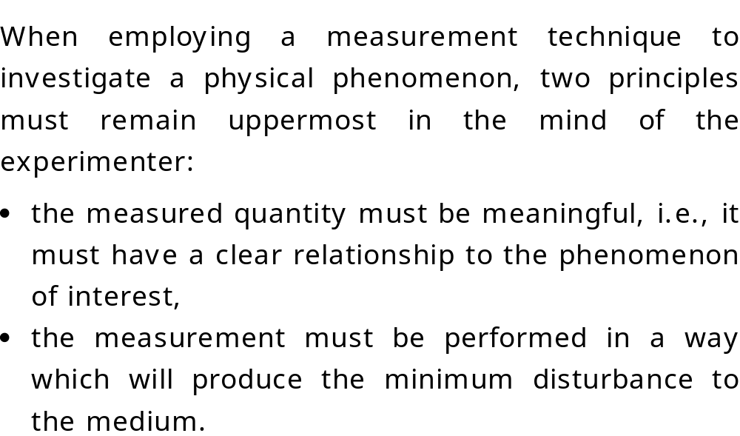
Measurement Basics
NWTF (IITK)

Slide 3
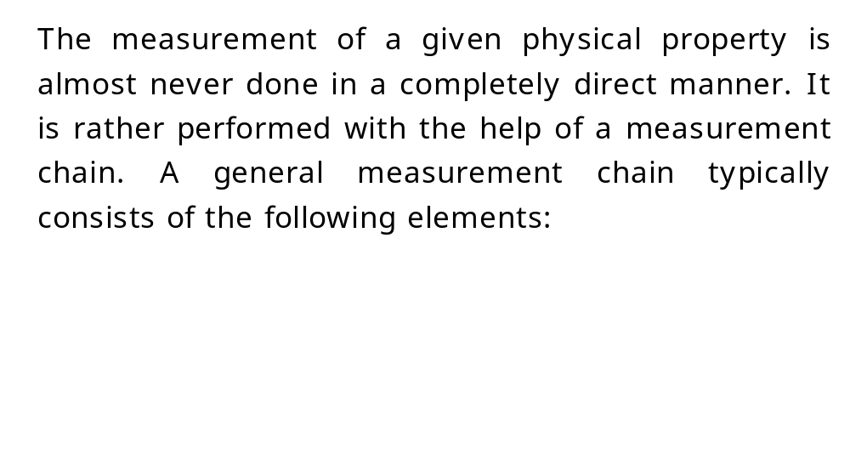
Measurement Chain
NWTF (IITK)

Slide 4
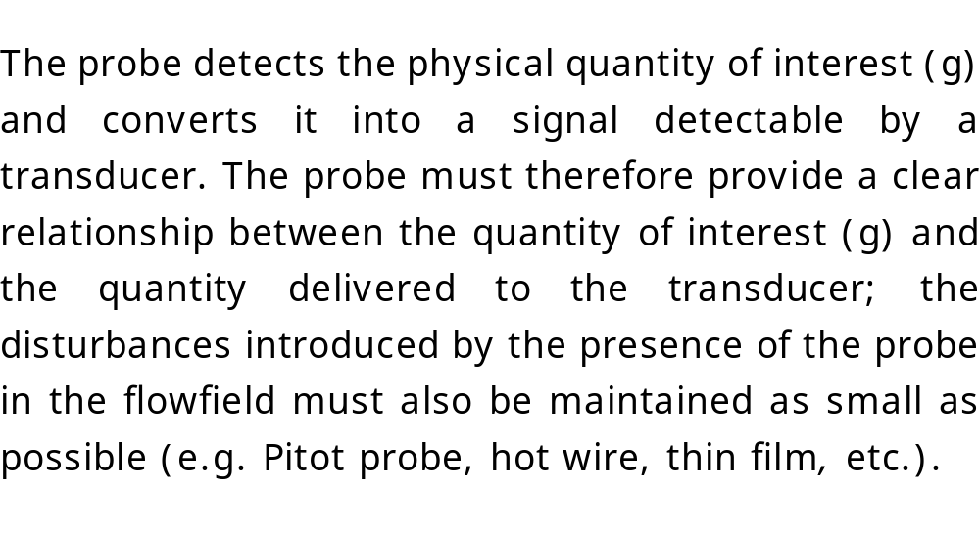
Probe
NWTF (IITK)

Slide 5
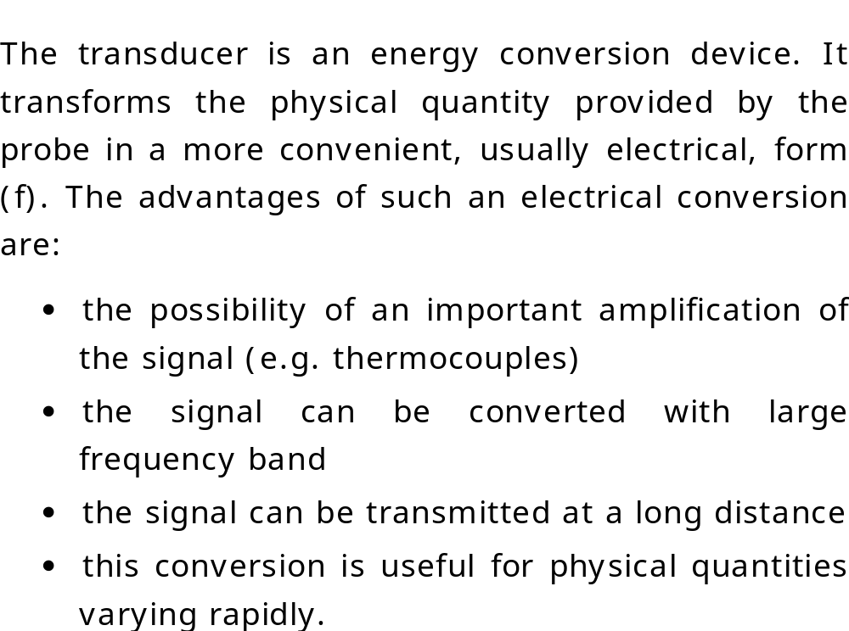
Transducer
NWTF (IITK)

Slide 6
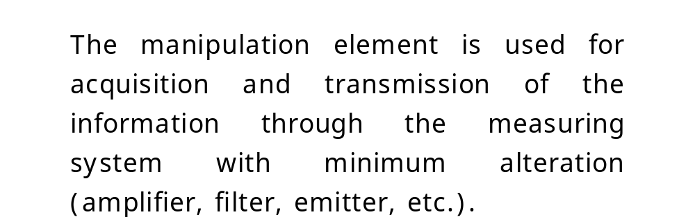
Manipulation Element
NWTF (IITK)

Slide 7
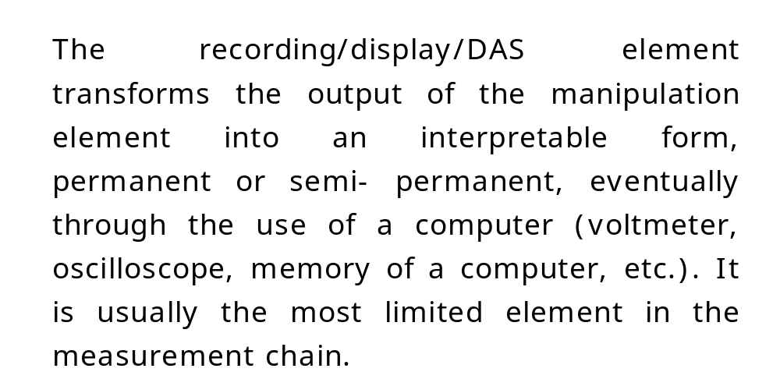
Display & Acquisition System
NWTF (IITK)

Slide 8
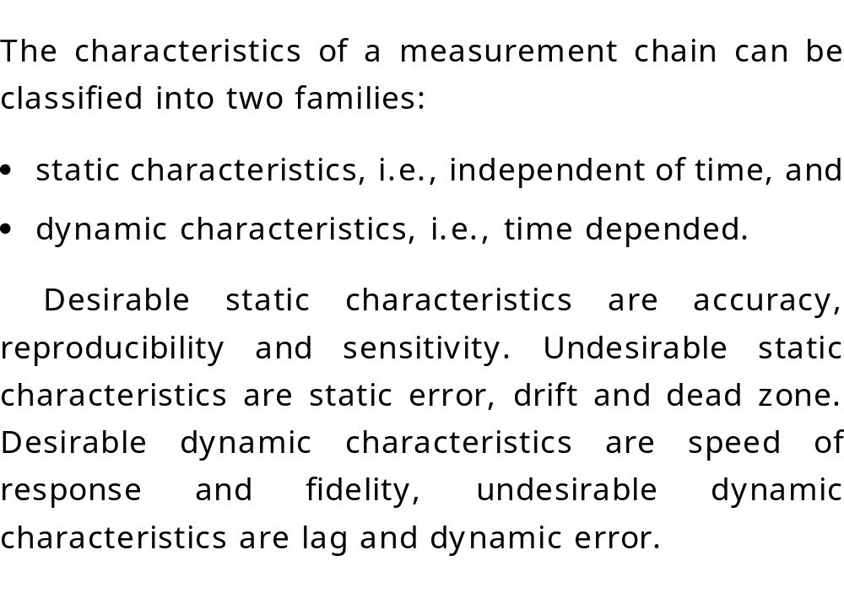
Characteristics of Measurement Chain
NWTF (IITK)

Slide 9
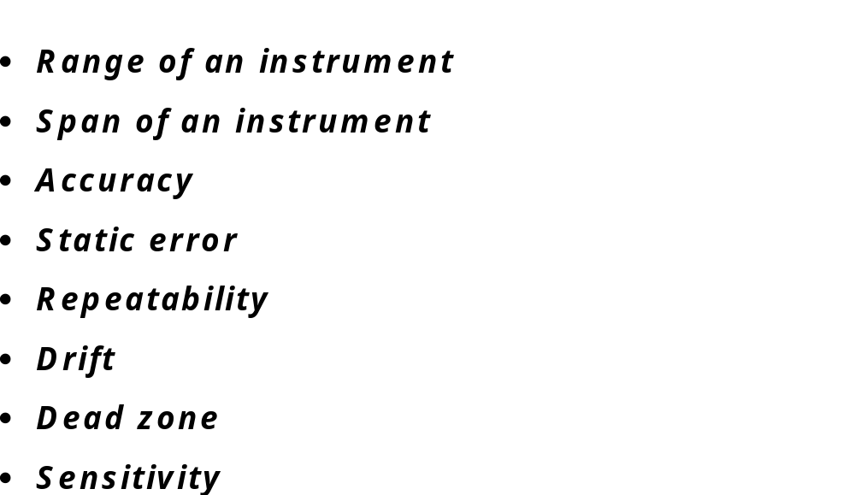
Static Characteristics
NWTF (IITK)

Slide 10
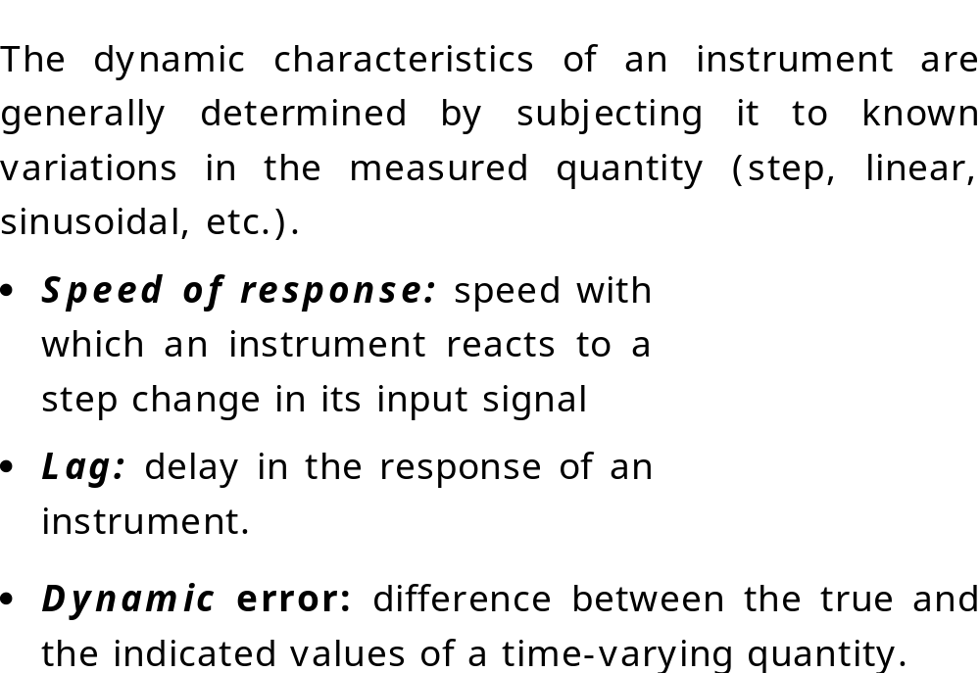
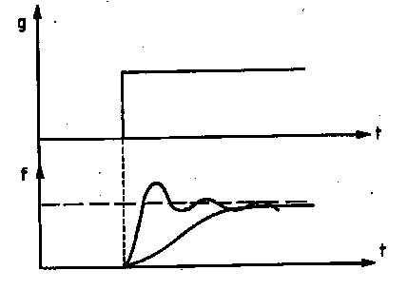
Dynamic Characteristics
NWTF (IITK)

Slide 11
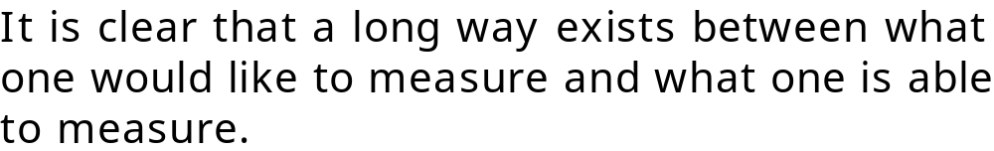
Interactions between measurement chain
and the environment
NWTF (IITK)

Slide 12
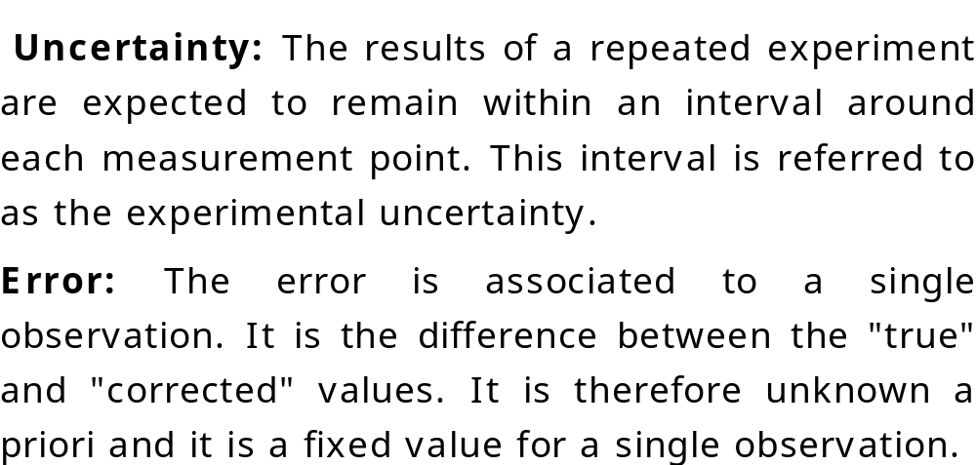
Error and Uncertainty
NWTF (IITK)

Slide 13
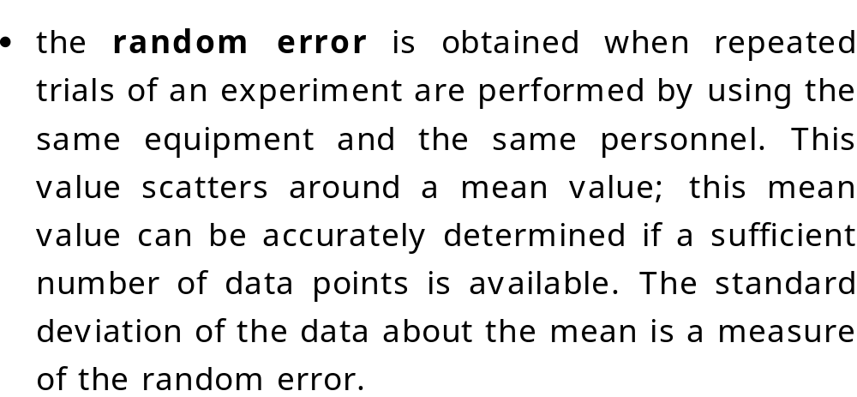
Random Error
NWTF (IITK)

Slide 14
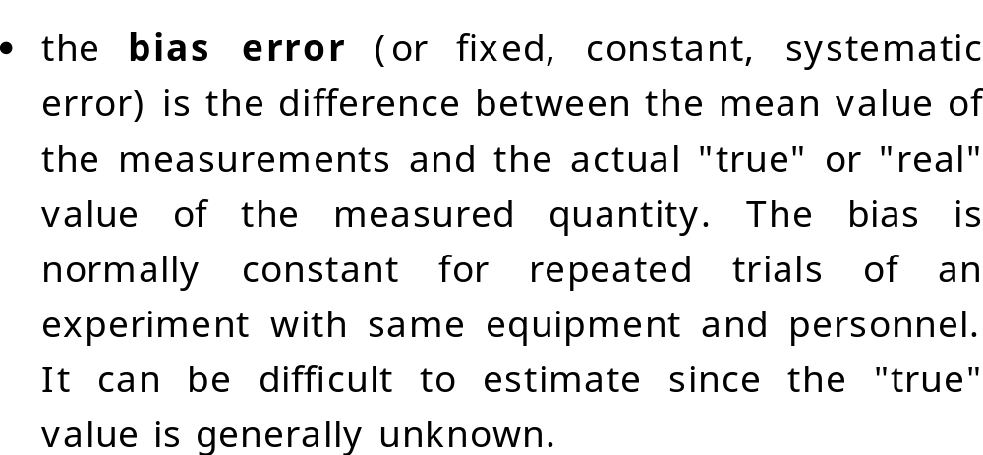
Bias or Systematic Error
NWTF (IITK)

Slide 15
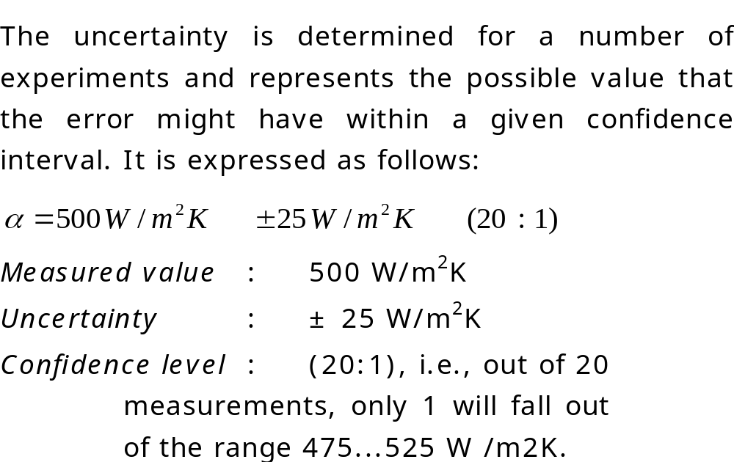
Uncertainty
NWTF (IITK)

Slide 16
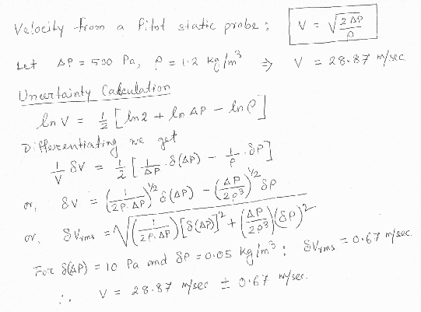
Uncertainty Calculation
NWTF (IITK)

